Slide 1
CSCI-1620
Exception Handling II

Slide 2
Exception Hierarchy
All exceptions inherit directly or indirectly from the Exception class
Exception in turn inherits from the Throwable class
Only Throwable subclasses can be used in exception handling

Slide 3
Errors
Errors also inherit from Throwable but differ from exceptions
Errors generally occur through problems with the JVM and cannot be recovered from
  OutOfMemoryError
They are rarely encountered and aren’t typically bothered to be caught

Slide 4
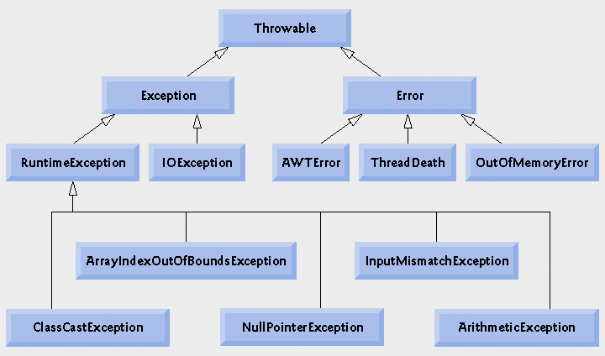
Exception Hierarchy

Slide 5
Checked vs. Unchecked
There are two categories of exceptions, checked and unchecked
The most frequent exceptions are unchecked, all that we’ve seen so far are unchecked exceptions
These most frequently arise from logical errors in code or user error

Slide 6
Unchecked Exceptions
It is also not required for these exceptions to be handled in order for the code to compile
They do not need to be explicitly declared as thrown by a method where that exception may occur
All RuntimeExceptions and Errors are unchecked

Slide 7
Checked Exceptions
Checked Exceptions are those that MUST be handled
If using a method that could throw a checked exception it is required that exception handling be written
These typically deal with File Input and Output exceptions and are easily anticipated
  User requests to open a file that does not exist
    Reprompt user for correct file

Slide 8
Checked Exceptions
All exceptions that inherit the IOException class are checked
Within a method if it is known that a checked Exception may occur, that method must explicitly declare that it may throw that Exception or catch it
Declaring is done with the throws keyword
Catching it will resolve the Exception

Slide 9
Checked Exceptions
Checked Exceptions were implemented in Java to force programmers to think about what IOExceptions may be thrown by a method
Seeing as most checked exceptions fall under file I/O they will be discussed and demonstrated later when we get to files

Slide 10
throws
Even though it is unnecessary, methods can explicitly claim that it throws an unchecked exception
This is done by a comma separated list of exceptions following the throws keyword after the parameter list of the method

Slide 11
throws
public class DivideZeroCatchMethod
{
public static int quotient(int num, int den) throws ArithmeticException
{
return num/den;
}
public static void main(String args[])‏
{
try
{
int result = quotient(5,0);
System.out.println(result);
}
catch(ArithmeticException AE)‏
{
System.out.println("Caught");
}
}
}

Slide 12
throws
Again, this is not necessary for unchecked exceptions but is given as an example on how to use throws

Slide 13
Exception
The Exception class itself is a checked exception and even though it is designed to be a superclass, if caught it will handle all of its subclasses
  An ArithemticException is-an Exception
So to test the difference between checked and unchecked we’ll alter the previous DivideZero program to throw an Exception and see how it must be handled

Slide 14
Causes Compile Error
public class DivideZeroThrow
{
public static int quotient(int num, int den)
{
if(den == 0)
throw new Exception();
return num/den;
}
public static void main(String args[])
{
try
{
int result = quotient(5,0);
System.out.println(result);
}
catch(Exception E)
{
System.out.println("Caught");
}
}
}

Slide 15
Checked Exceptions
Checked Exceptions have a catch-or-declare requirement
If a method throws a checked exception it must either catch it or declare that it throws it
Catching it will handle the exception
Declaring it will cause the method call itself to rethrow the exception
If this requirement is not satisfied, the program will not compile
This way all checked exceptions will be handled eventually

Slide 16
finally Block
A finally Block, or finally clause can immediately follow the last catch block in a try/catch statement, or after the try block if no catch statements are given
Every try statement must have at least one catch block OR a single finally block

Slide 17
finally Block
A finally block is guaranteed to execute whether or not an exception is thrown or is caught in a corresponding try block
The one exception to this is if the program terminates early by the try statement calling upon System.exit

Slide 18
finally Block
What is the purpose?
Programs may open up resources in execution, such as text files, databases or network connections
In order to avoid resource leaks, the finally block is used to guarantee these resources are freed up
If these resources are not freed other programs may not be able to access them
Typically resources are opened and used within a try statement to catch possible exceptions concerning that resource
Once the try statement is done, whether or not Exceptions occurred, it is important to free up the resource

Slide 19
public class finallyTest
{
public static void main(String args[])‏
{
System.out.println("This program consists of two try blocks, each with a finally clause.");
System.out.println("The first will throw an exception, the second will not.");
try
{
System.out.println("\nThis try block does not throw.");
}
catch(Exception exception)‏
{
System.out.println("Exception caught!");
}
finally
{
System.out.println("In finally block.");
}

Slide 20
try
{
System.out.println("\nThis try block does throw.");
throw new Exception();
}
catch(Exception exception)‏
{
System.out.println("Exception caught!");
}
finally
{
System.out.println("In finally block.");
}
System.out.println("\nfinally blocks are always executed!");
}
}

Slide 21
Stack Unwinding
If an exception is not caught in the block or method in which it was thrown, that doesn't mean it can't be caught
The exception will be passed throughout the outer blocks and method calls as well
This is known as Stack Unwinding
If the exception is never caught, the program will terminate
  Or not compile in the case of a checked exception

Slide 22
printStackTrace(), getStackTrace(), getMessage()
These are all methods that are implemented by class Throwable
All exceptions are subclasses of Throwable and therefore capable of invoking these methods
Can be very useful for debugging

Slide 23
Stack Unwinding/Throwable methods
public class unwinding
{
public static void main(String args[])‏
{
try
{
method1();
}
catch(Exception exception)‏
{
System.out.printf("%s\n\n", exception.getMessage());
exception.printStackTrace();
StackTraceElement[] traceElements = exception.getStackTrace();
System.out.println("\nStack trace from getStackTrace:");
System.out.println("Class\t\tFile\t\tLine\tMethod");

Slide 24
for(StackTraceElement element: traceElements)‏
{
System.out.printf("%s\t", element.getClassName());
System.out.printf("%s\t", element.getFileName());
System.out.printf("%s\t", element.getLineNumber());
System.out.printf("%s\n", element.getMethodName());
}
}
}
public static void method1() throws Exception
{
method2();
}
public static void method2() throws Exception
{
method3();
}
public static void method3() throws Exception
{
throw new Exception("Exception thrown from method3");
}
}

Slide 25
Creating New Exception Types
It is possible to create your own exception types for problems that may arise unique to your code
A created exception type must inherit from an existing exception to ensure it works like other Exceptions
Generally, we will inherit from RuntimeException if we want an unchecked Exception, or inherit from Exception if we want a checked Exception
We'll come back to this idea later

Slide 26
Assertions
Useful tool for debugging
Assertions are ignored by regular execution
Allows you to raise an error based upon a conditional statement
To run a program using assertions
  java -ea filename

Slide 27
Assertions
Assertions have two uses
  assert condition;
  assert condition:String;
In the first form, if the condition is false the program terminates, throwing an AssertionError
In the second form, if the condition is false the program terminates and throws an error with the String as the error message

Slide 28
import java.util.Scanner;
public class assertTest
{
public static void main(String args[])‏
{
Scanner input = new Scanner(System.in);
int x;
System.out.print("Enter a number between 1 and 10: ");
x = input.nextInt();
assert (x >= 0 && x <= 10) : "bad number: " + x;
System.out.printf("You entered %d\n", x);
}
}

Slide 29
Assertion
Assertions are not meant to be used for normal error handling
Assertions are strictly meant for debugging purposes and should never be encountered in normal use

